Slide 1

Food Safety Fundamentals
TB MED 530 / NAVMED P-5010-1 / AFMAN 48-147_IP
Tri-Service Food Code
Force Health Protection and Preventive Medicine
USAMEDDAC-K
Environmental Health
UNCLASSIFIED

Slide 2
Purpose & Objectives
Purpose – Present essential food safety and sanitation practices that must be applied in all food operations.
Objective – Prevent the occurrence of foodborne illness attributed to unsanitary food operations, poor employee hygienic practices, or poor food handling practices.
Scope of Training –
  Understand the hazards to food.
  Understand risk factors that contribute to foodborne illness.
  Understand controls prescribed in TB MED 530 that will minimize the risk of foodborne illness.
2

Slide 3
Training Outline
Foodborne Illness
Food Safety Hazards
Key Terms
Foodborne Illness Risk Factors
Layers of Protection
  Personal Hygiene Practices
  Time/Temperature Controls
  Proper Cleaning and Sanitizing
Quiz
3

Slide 4
Foodborne Illness
Just because you don’t hear about it often, doesn’t mean it doesn’t happen… Only a small percentage of actual foodborne illness cases ever get reported—
Personnel who prepare and handle food play a key role in the prevention of foodborne illnesses by—
  Adhering to prescribed food safety measures; and
  Maintaining sanitary controls within food operations.
48 million people each year
128,000 hospitalizations
3,000 deaths
DFAC food employee implicated as Salmonella carrier—
causes outbreak involving 110 Soldiers
4
Notes:
Instructor Notes
Only a small percentage of actual foodborne illness cases ever get reported. In a 2011 study conducted by the Centers for Disease Control and Prevention, it was estimated that nearly 1 in 6 Americans (or 48 million people) get sick every year because of diseases transmitted through food. These illnesses result in over 128 thousand hospitalizations and 3,000 deaths.
Even in the military, documenting the occurrence of foodborne illnesses is a challenge. Only about ten percent of all foodborne illnesses are reported or properly diagnosed; many cases of foodborne illness are dismissed by medical practitioners as the 24-hour flu. Foodborne illness can have disastrous results. Some can lead to death, while most will incapacitate a person, or unit for several days.
Foodborne illnesses are preventable. Behind every foodborne illness are several factors that contributed to, or cause the illness. This training is designed to alert you to the leading causes of foodborne illness and the control measures that you can take to reduce the risk of occurrence.

Slide 5


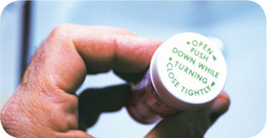
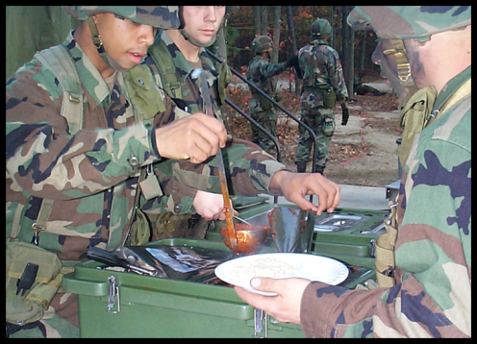
Foodborne Illness (continued)
Highly susceptible populations—
These people have a higher risk of getting
a foodborne illness:
  Elderly people
  Preschool-age children
  People with compromised immune
  systems; hospital inpatients
  People taking certain medications
Personnel operating in a “high stress”
environment:
  Soldiers in Basic Training
  Soldiers engaged in field training exercises
  lasting longer than 2 weeks
  Deployed personnel
5
Notes:
Instructor Notes
Elderly people are at high risk because their immune systems have weakened with age.
Very young children are at high risk because they have not built up strong immune systems.
People with compromised immune systems include:
People with cancer or on chemotherapy
People with HIV/AIDS
Transplant recipients
People taking certain medications
High stress environments associated with military operations coupled with reduced sleep may weaken an individual’s immune system. Military operations that are recognized as “high stress” include, but are not limited to—
Soldiers attending basic training;
Soldiers engaged in extended field training exercises or military schools, such as Ranger, Airborne, Air Assault, lasting 2 weeks or longer; and
Deployed personnel.
These situations present high operational demands on Soldiers, generally affords little rest, and occur in less than optimum environmental settings where sanitary controls are reduced.

Slide 6
Food Safety Hazards
Harmful substances that present a food safety hazard can be Chemical, Physical, or Biological in nature and may result in injury or illness when ingested. Examples include—
  Chemical: detergents, sanitizing agents, pesticides, fuel, etc…
    Contamination of food or food contact surfaces (equipment/utensils) occurs through direct contact with chemicals or chemical residues following improper use or storage.
  Physical: bone fragments, glass, toothpicks, etc…
    When physical hazards such as insects and hair come into contact with food, biological contaminants contained on their surfaces are transferred to the food.
  Biological: bacteria, viruses, parasites, yeast, & molds
    Biological hazards contribute to almost two-thirds of all foodborne illness outbreaks.
    Biological agents that make you sick are called “pathogens”.
6
Notes:
Instructor Notes (Click mouse to animate first bullet for discussion)
The threat of foodborne illness or injury comes from the hazards found in food. Food safety hazards are harmful substances that are chemical, physical, or biological in nature. (Click mouse to animate next bullet)
Chemical hazards involve intoxication due to chemical contamination of food.
Toxic Metals -- Excessive amounts of metal residues in food can be toxic. Some metals, however, produce a toxic effect in minute quantities. Foods can become contaminated when the wrong equipment is used in the dining facility. If we use a galvanized container to prepare or store acidic foods, such as orange juice, lemon aid, or tomato sauce, a chemical reaction will occur, causing the zinc to leach out of the metal coating and contaminate the product. Lead-based flatware and crystal can present a similar problem. People have also become sick by using refrigerator shelves, containing cadmium, as barbecue grills. When we prepare foods, we must use only equipment designed for that use.
Residues from detergents, cleaning solutions, or concentrated sanitizers may also present itself as a problem. Food service personnel must only use chemicals approved by the Environmental Protection Agency (EPA) for food service. Also, all chemicals should be used IAW the manufacturers’ label and proper HAZCOM procedures must be followed for handling and storage.
Pesticides -- Chemicals can get into our foods by misusing pesticides either on the farm or in our facility. One example of this is using bug spray in food preparation areas. Food service workers are prohibited by TB MED 530 to apply pesticides in food storage, preparation, or service areas. The best control measures to reduce the potential of pesticide residue intoxication are to purchase food only from veterinary approved sources and to wash all fresh fruits and vegetables regardless of their source. (Click mouse to animate next bullet)
Physical hazards involve injuries caused by chewing or ingesting foreign objects in food. Although physical hazards are serious to the individual affected, it is not as significant as biological hazards. Unlike bacteria, the threat of a physical hazard impacts fewer people because it does not multiply or spread on its own. Wood fragments, stones, bones, metal shavings, and broken glass are among some of the physical hazards that can cause injury. Other physical hazards include particulates, such as hair, fingernail fragments, and sputum. These items will not cause a physical injury, but they will introduce harmful bacteria to food, which can lead to foodborne illness. (Click mouse to animate next bullet)
Biological hazards present the most significant threat, accounting for at least two thirds of foodborne illnesses.
Bacteria, viruses, parasites make up the group of biological hazards. Biological agents that cause foodborne illness are commonly refer to as “pathogens” or “pathogenic organisms”. Fungi, such as yeast and molds, are included in the biological hazard group, but they mostly contribute to food spoilage rather than foodborne illness.
Within this group, bacteria are generally the greatest cause of foodborne illness.
Although food is generally the primary mechanism by which biological hazards are transmitted to an individual, viruses deposited on equipment surfaces from contact with an infected person can subsequently be transferred to food equipment or other individuals when contact is made with the contaminated surface.

Slide 7
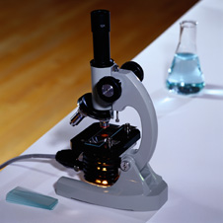
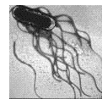

Biological Hazards
The Nature of Bacteria
Bacteria are microscopic and
cannot be seen by the naked eye.
  Hundreds or thousands of bacteria
  may already exist on raw foods when purchased.
The right temperature, moisture, and food are needed for bacteria to survive and multiply.
  Double in numbers every 15-30 minutes under ideal conditions.
7
Notes:
Instructor Notes
Because biological hazards present the greatest threat to food safety, it is important for us to understand how they affect us. The remainder of this training will be focused on controlling the biological hazards.
Bacteria are microscopic. You can’t see them or smell them when they are present in food. In order to survive, bacteria need to be in contact with food. Under ideal temperature and moisture conditions, bacteria will double in numbers every 15 to 30 minutes.

Slide 8
Biological Hazards (continued)
The Nature of Bacteria
Bacteria in food can cause:
  Infection - illness caused by ingesting a sufficient amount of live bacteria.
  Intoxication – illness caused by ingesting the toxic chemical residues deposited in food when the bacteria was alive.
Toxins—
Poison (waste products) produced by some living bacteria.
The longer bacteria are allowed to grow/multiply in food, the greater the amount of toxins deposited.
Are NOT neutralized (destroyed) during cooking or freezing.
8
Notes:
Instructor Notes
Bacteria can affect us two ways: infection or intoxication.
Infection results from eating the living organisms or cells.
Most foodborne pathogens reproduce well at temperatures that are close to that of the human body. When living cells are ingested, the human body serves as an incubator, allowing pathogens to grow and multiply.
Most infective bacterial pathogens will reproduce rapidly at temperatures that are above 41ºF and below 135ºF.
Factors that promote the growth of harmful bacteria include adequate nutrients, moisture, and a neutral pH (or acidity level) of the food. These are the characteristics that designate foods as potentially hazardous and requiring time or temperature control to ensure its safety.
Intoxication is defined as an illness that results from eating toxins.
Some bacteria produce one or more toxins, which are chemical residues deposited as a byproduct during cellular reproduction.
Toxigenic bacteria are also infective in that the living (or vegetative) cells will cause illness when ingested.
Cooking may destroy living bacterial cells, however, toxins deposited by the bacteria are generally heat stable and are not destroyed or neutralized during cooking; this results in a foodborne-intoxication.
Illness resulting from foodborne intoxication generally will show within 30 minutes or up to a few hours after eating a contaminated food.

Slide 9
Biological Hazards (continued)
The Nature of Bacteria
Some bacteria produce spores--
  Dormant bacteria cell deposited during cellular reproduction.
  Survival mechanism that ensures the cell will be protected when environmental conditions are adverse (hot or cold).
  Dormant bacteria cells “wake up” when environmental conditions are ideal.
  Can survive boiling temperatures for long periods of time; NOT destroyed during cooking or freezing.
9
Notes:
Instructor Notes
Some bacteria produce spores. What are spores and how do they act?
Spores are dormant cells formed by some bacteria as a protective measure against adverse conditions. The dormant cell is encapsulated in a hard protein coat that protects the nucleus of the cell.
Because of the protective coating, spores are not destroyed during cooking or freezing processes. Spores lie dormant until environmental conditions are conducive for growth.
Adequately cooking of foods (such as green beans and rice) that are potentially contaminated with spore-forming bacteria may destroy living bacterial cells, rendering the product safe to eat. However, spores are left undestroyed in the product. Potentially hazardous foods held at unsafe temperatures between 41 and 135ºF for several hours prompt these spores to “wake up” and begin multiplying.

Slide 10
Biological Hazards (continued)
Bacterial Infective Pathogens
These do not produce toxins or spores—
  Salmonella
  Campylobacter jejuni
  Shigella
  Listeria monocytogenes
Originate from intestinal tract of animals.
Associated with fecal contamination of food during processing (slaughter).
Cool, damp environments -- floor drains & refrigerators
10
Notes:
Instructor Notes
There are several hundred species of bacteria that contribute to foodborne illnesses. For the purpose of this class, it is not important to know what they are, but rather, where they come from and how they affect us.
Bacteria such as Salmonella, Campylobacter, E-coli, and Shigella are examples of infective foodborne pathogens. These bacteria do not produce toxins or spores. Illness occurs when a sufficient number of living cells are ingested. These pathogens are naturally found in the intestinal tract of animals and can be cultured from most soils.
Salmonella -- The main vehicles for transmitting salmonella are meat, poultry, raw or partially cooked eggs or egg products, unpasteurized milk or dairy products, and raw seed sprouts.
Campylobacter -- Campylobacter contamination of dairy products, poultry, pork, beef, and lamb is probably even more common than salmonella.
Shigella -- Bloody diarrhea is a common symptom of Shigellosis. When infected workers fail to wash their hands properly, they transmit the bacteria to food. Flies are also thought to be responsible for the transmission of this bacteria.
Listeria bacteria is also an infective pathogen that does not produce a toxin or spores. This bacteria is commonly found in cool, damp environments such as floor drains or condensation lines inside refrigeration units.
Foods commonly affected by listeria include raw, soil-grown vegetables, dairy products, raw meats and poultry, and pre-cooked meats such as deli meats and hot dogs.
The most effective means of control within the food establishment is to prevent condensation on fans in refrigerators from dripping onto food and to keep facilities and floors clean and dry.

Slide 11
Biological Hazards (continued)
Toxigenic Bacterial Pathogens
Infective bacteria that also produce a toxin—
  Escherichia coli 0157:h7 (E. coli)
  Staphylococcus aureus
Intestinal tract of animals & humans.
Readily found in soil.
Human hair, skin, hands & throat
11
Notes:
Instructor Notes
There are many bacterial pathogens that cause foodborne intoxication because of the toxins they produce. We are going to look at some of the more common agents that have been implicated in recent foodborne illness outbreaks: E. coli, Staphylococcus aureus, Clostridium perfringens, Clostridium botulinum, and Bacillus cereus.
E. coli can cause both an infection and intoxication.
The bacteria is found in the intestinal tract of both humans and animals and is readily found in soil.
Fecal contamination of meats and poultry occur during slaughter and processing. Surveys indicate that up to 97 percent of swine carcasses, 73 percent of beef carcasses, and 81 percent of chicken carcasses are contaminated with E. coli.
Foods that come into contact with the ground, such as melons, seed sprouts, and leafy greens, have also been implicated in outbreaks of E. coli. In recent years there were two multi-state outbreaks involving ready-to-eat bagged salads and raw clover sprouts.
Staph bacteria is readily found on human hair, skin, hands, and in nasal and throat passages.
Staph bacteria can make us sick by both infection and intoxication.
It is estimated that 4O to 5O percent of all healthy human adults carry this bacteria.

Slide 12
Biological Hazards (continued)
Toxigenic Bacterial Pathogens
Spore-forming, toxigenic bacteria—
  Clostridium perfringens
  Clostridium botulinum
  Bacillus cereus
Intestinal tract of animals & humans.
Soil.
Soil
12
Notes:
Instructor Notes
Each of the bacteria presented on this slide produce a toxin as well as spores.
Clostridium perfringens is found in the soil and the intestinal tract of humans and animals. The living cells of C. perfringens located on the surface of foods are normally killed by cooking, however, heat‑stable spores will survive and revert back to a living cell if the food is held at unsafe temperatures for a long enough period of time after cooking. This bacteria is commonly known as the “leftover disease” because outbreaks usually occur as a result of improper cooling of leftovers at the end of a meal period.
Clostridium botulinum and Bacillus cereus are naturally found in soil and are commonly associated with vegetables and grains.
Cooked foods, such as rice and pasta, will promote the growth of Bacillus cereus bacteria if they are not held at 135º F or above.
Clostridium botulinum produces a neurotoxin that causes botulism. This bacteria needs an anaerobic (or low oxygen) environment to grow, such as a sealed can of vegetables or soup. Swollen cans should never be used because it indicates there is active growth of occurring in the can, which could be attributed to C. botulinum bacteria. Botulism can also occur as a result of improper food processing at a food establishment. Inadequate heating or cooling presents a problem in the interiors of large food masses such as a 5 or 10 gallon stockpot of beef stew, chili, or other liquid-based product because of the anaerobic conditions that exist in these deep pots. If steps are not taken to rapidly heat or cool these large masses, the anaerobic conditions in the center of the pot will allow C. botulinum bacteria to grow.

Slide 13
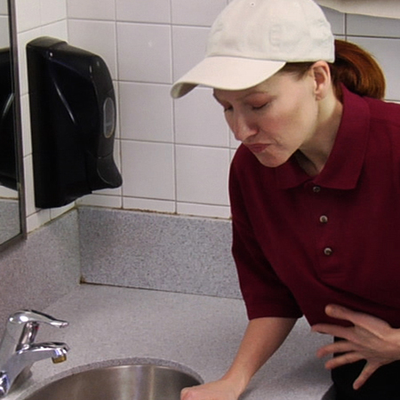
Biological Hazards (continued)
Common symptoms of foodborne illness:
  Diarrhea
  Vomiting
  Fever
  Nausea
  Abdominal cramps
  Jaundice (yellowing of skin and eyes)
Onset time:
  Depend on the type of foodborne illness
  Can range from 30 minutes to six weeks
13
Notes:
Instructor Notes
The symptoms of a foodborne illness vary depending on the illness type or causative agent. Most victims of foodborne illness, however, do share some common symptoms.
Not every person affected by a foodborne illness will have all of these symptoms and the symptoms of foodborne illness are not limited to this list.
How quickly foodborne-illness symptoms appear in a person is known as the onset time of the illness. Onset times depend on the disease-causing agent and whether the illness is due to infection or intoxication.
They can range from as little as 30 minutes to as long as six weeks. How severe the illness is can also vary, from mild diarrhea to death.
Typically, symptoms of a foodborne infection may present within 1 to 2 days or it may take a week or more before there is enough of the infective agent in the person’s intestinal tract to start making them sick. Remember, the human body acts like an incubator.
If a toxin is producing the foodborne illness, symptoms are likely to present within 30 minutes or up to 36 hours after the exposure. The amount of the toxin and type of toxin ingested will determine how rapid the symptoms will present.

Slide 14
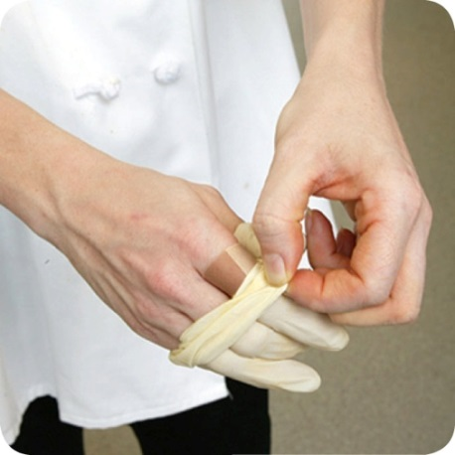
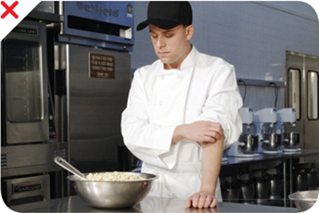
Health Requirements (continued)
Infected wounds and unhealed cuts or
blistered burns—
  Must be covered to prevent pathogens from contaminating food and food-contact surfaces.
How a wound is covered depends on where it is located:
  Hand or wrist – use impermeable cover (bandage or gauze covered by a finger cot) and then cover with a single-use glove.
  Arm – use impermeable bandage.
    If work smock has full or three-quarter
    sleeves, always wear the sleeves down.
  Body – cover with dry, tight-fitting
  bandage.
14
Notes:
Instructor Notes
Seepage from an open or infected wound can lead to the contamination of hands, food, and food equipment if incidental contact is made with the infected area or contaminated clothing that is in direct contact with the wound.
Employees must cover any infected wound regardless of where it is located on the body.
Open wounds to include unhealed scabs and blistered burns that have not dried must be covered with an impermeable bandage.
If the wound is located on a finger or the front or back of the hand, the employee must further cover the bandaged area with a disposable glove.
Employees who wear work smocks designed with three-quarter sleeves must always wear the uniform with the sleeves fully extended. This is especially important to further prevent potential contact with food or food contact surfaces if the worker has a bandaged wound on their forearm.

Slide 15
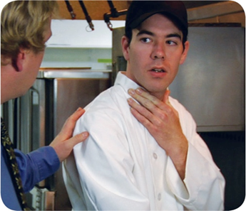
Health Requirements (continued)
Disclosure by Workers—
Reportable symptoms:
  vomiting
  diarrhea
  jaundice
  sore throat with fever
  infected wound or lesion with pus (oozing boils, pimples, and sores)
Personal Hygiene & Work Habits
15
Notes:
Instructor Notes
If you are experiencing any of the symptoms presented on this slide, it is your obligation to report it to your supervisor so appropriate action can be taken.

Slide 16
Health Requirements
Disclosure by Workers—
Reportable diagnosis or history of exposure
  Reported during occurrences while holding an event
Personal Hygiene & Work Habits
Individual Diagnosis …or | …Reportable Exposure
Norovirus | Within past 48 hours
Enterohemorrhagic (EHEC) or Shiga Toxing-Producing E. coli (STEC) | Within past 3 days
Shigella spp. | Within past 3 days
Salmonella Typhi | Within past 14 days
Hepatitis A virus | Within past 30 days
16
Notes:
Instructor Notes
Even though handwashing is key to preventing the spread of harmful microorganisms, it is equally important to exclude sick employees from coming to work or to restrict their activities within the food operation.
Food employees have an obligation to report or disclosed to their employer certain health conditions or exposure to diseases that can be transmitted through food.
If you were diagnosed by a health practitioner as having one of the illnesses listed in this table, you must disclose it to your employer when you were first hired and if you are diagnosed at any time during the course of your employment.
If during your employment you were exposed to someone who was diagnosed
With some illnesses, a person may infect others before showing any symptoms. For example, a person could spread hepatitis A for weeks before having any symptoms.
With other illnesses, a person may infect others for days or even months after symptoms are gone. Norovirus can be spread for days after symptoms have ended.
Some people carry pathogens and infect others without ever getting sick themselves. These people are called carriers.

Slide 17
Biological Hazards (continued)
Those handling/serving food that present with any symptoms of foodborne illnesses MUST EXCLUDE themselves from serving or handling foods.
  It is the responsibility of BOTH the event coordinator and food handler to ensure that no food handlers/servers are sick with a foodborne illness.
Report ALL reportable exposure to the MEDDAC- K, Preventive Medicine, Environmental Health at DSN: (315) 737-2662, 737-5762

Slide 18
Key Terms
A Foodborne Illness Outbreak is defined as 2 or more cases of a similar illness resulting from the ingestion of a common food.
  Ice and beverages are included as a “food”.
  The outbreak may be confirmed through laboratory analysis where the causative agent is identified.
  Some outbreaks, such as Norovirus, are not always linked to a specific food, but can be linked to a specific facility where an infected food employee was working.
18
Notes:
Instructor Notes
The next series of slides contain terms or concepts that are commonly used when discussing food safety. It is important to understand the meaning of these terms as we continue our discussion regarding control measures.

Slide 19
Key Terms (continued)
Contaminated – The presence of harmful substances (physical, chemical, or biological) in or on food.
Clean – Clean to sight and touch means there is no visible debris, encrusted food, or greasy feeling.
Sanitize – Sanitizing is a process of reducing the total number of micro-organisms (“germs”) on a surface to safe levels.
  This is NOT the same as “sterilization,” which is a process used in hospitals to kill (remove) all micro-organisms that are on a surface.
19
Notes:
Instructor Notes
(Click the mouse to show each term)

Slide 20
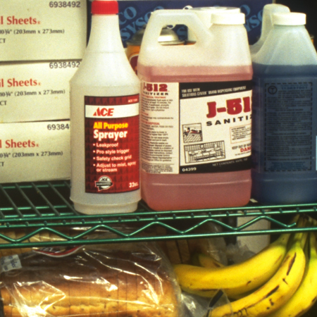
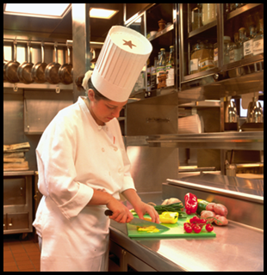
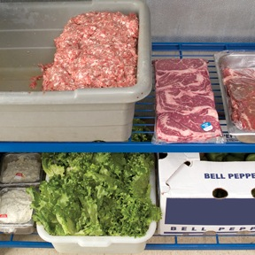
Key Terms (continued)
Cross-contamination – The transfer of a harmful substance to food through direct or indirect contact—
  Spilled chemicals or detergents on food
  packages or surfaces where food comes
  into direct contact.
  Using unsanitized equipment or utensils to
  prepare, store, or serve food.
  Bare-hand contact with foods that are ready-to-eat (RTE).
  Bacteria from raw protein foods transferred to foods that are RTE.
20
Notes:
Instructor Notes
Cross-contamination is the transfer of a harmful substance to food through direct or indirect contact—
Spilled chemicals or detergents on food packages or surfaces where food comes into direct contact, such as plates, silverware, and food prep tables.
Using unsanitized equipment or utensils to prepare, store, or serve food.
Bare-hand contact with foods that are ready-to-eat (RTE) such as fresh fruits, sandwiches, salad vegetables, and deli meats & cheese.
Bacteria from raw protein foods transferred to foods that are RTE. For example—
Blood from raw meat dripping onto RTE foods stored on a lower shelf in the refrigerator.
Cutting boards and knives used to prepare raw meat are not cleaned and sanitized and are then used to prepare RTE foods.

Slide 21
Key Terms (continued)
Time/Temperature Controlled for Safety (TCS) Food (Previously referred to as Potentially Hazardous Food, Time/temperature controlled for safety) – A food that requires time or temperature control to limit the growth of harmful micro-organisms or the formation of toxins.
  The relationship between various factors will determine if a food requires time/temperature control for safety.
    pH of the food
    Water activity of the food
    Interaction between the pH and water activity
    Heat treatment of the food
    Packaging
21
Notes:
Instructor Notes
Time/temperature control for safety food was previously called “potentially hazardous food, time/temperature controlled for safety”. A food requires time or temperature control if it is capable of supporting growth of harmful microorganisms that can cause a foodborne illness. The definition of TCS food takes into consideration the pH of the food, the water activity of the food, the interaction between the pH and water activity of the food, heat treatment of the food, and packaging.
Note that foods that are categorized as non-PHFs do not support microbial growth, but they can serve as a vehicle for spreading viruses and toxins if they become contaminated.

Slide 22
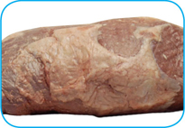
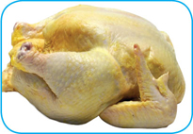
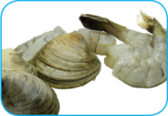
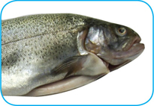
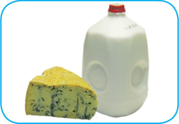
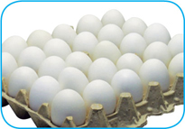
Time/Temperature Control for Safety Foods
Obvious foods include—
  Raw or heat-treated (cooked) animal food:
    Meat: beef, pork, lamb
    Poultry
    Seafood: fish, shellfish, crustaceans
    Dairy products
    Shell eggs*
    (except pasteurized shell eggs)
22
Notes:
Instructor Notes
Obvious TCS Foods include--
Meat: beef, pork, and lamb
Poultry
Fish
Shellfish and crustaceans
Milk and dairy products
Shell eggs –
*Shell eggs that have been pasteurized are NOT considered a TCS food because they have been treated to eliminate Salmonella.
* Hardboiled eggs (eggs cooked until the yolk is solid) that are retained with the shells intact are also NOT considered a TCS food.
Under both of these conditions, the application of a heat treatment destroys the Salmonella bacteria that is inside the shell. The shell is a non-permeable membrane, which prevents any new contaminants from entering the shell. Once the shell has become compromised (either cracked or removed), these products become potentially hazardous because the pH, water activity, and nutrients of the product will support microbial growth when left at unsafe temperatures.

Slide 23

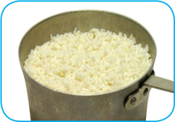
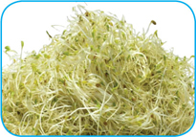
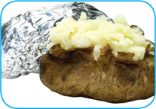
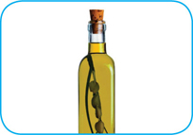
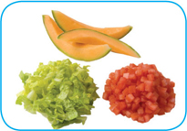
TCS Foods (continued)
Other previously designated foods include—
  Heat-treated plant food -- rice, pasta, baked
  potato, fried onions, cooked apples…
  Raw seed sprouts
  Cream pies
  Gravies
  Cut melons
  Chopped garlic in oil
Newly designated foods include
cut plant foods (raw)—
  Cut tomatoes
  Cut leafy greens: spinach, salad
23
Notes:
Instructor Notes
Other previously recognized TCS foods include:
Heat-treated plant food. This includes products such as cooked rice and pasta, reconstituted dried beans, baked potatoes, vegetables, and fruits used in pies.
Tofu or other soy protein; synthetic ingredients, such as textured soy protein in meat alternatives;
Sprouts and sprout seeds;
Sliced melons;
Untreated garlic-and-oil mixtures
New items now recognized as TCS foods include cut tomatoes and cut leafy greens, such as spinach and salad. Slicing these products increases the amount of moisture available to promote bacterial growth. Additionally, there is a wider variety of tomatoes available to consumers, some of which have been grown to be less acidic. As a result we can no longer assume that the pH level of tomatoes will prevent microbial growth.

Slide 24
Key Terms (continued)
Ready-to-eat (RTE) Food – A food that can be eaten without further preparation, washing, or cooking. Examples include—
  Food that has already been cooked
  Washed fruits and vegetables (whole or chopped)
  Deli meat & cheese
  Bakery items
  Sugar, spices, and seasonings
24
Notes:
Instructor Notes
Like TCS food, ready-to-eat food also needs careful handling to prevent contamination.

Slide 25
Foodborne Illness Risk Factors
There are 5 major risk factors (or conditions) related to employee behaviors and food preparation practices that contribute to foodborne illness:
  Food from unsafe sources
  Inadequate cooking
  Improper holding temperatures
  Contaminated equipment
  Poor personal hygiene
25
Notes:
Instructor Notes
The majority of foodborne illnesses have multiple causes and consist of multiple failures or mistakes in the food production process.
A recent study by the Center for Disease Control and Prevention has identified 5 leading factors that contribute to foodborne illness:
Foods that are obtained from unsafe sources.
Foods not cooked to the proper temperature needed to kill harmful bacteria.
Foods held at improper holding temperatures, which allows harmful bacteria to grow.
Contaminated equipment used to prepare or handle food.
Poor personal hygiene practices.
As a food employee it is your duty to understand and employ the controls associated with these key risk factors to protect the health of your customers by preventing foodborne illnesses from occurring.

Slide 26
Layers of Protection
Risk factors controlled by all food employees:
  inadequate cooking
  improper holding temperature
  contaminated equipment
  poor personal hygiene
Applying multiple levels of control called the Layers of Protection is the underlying principle for reducing
the risk of foodborne illness
from biological
hazards.
Proper Cleaning & Sanitizing
Personal Hygiene & Work Habits
Time & Temperature Discipline
26
Notes:
Instructor Notes
Click the mouse to show the first main bullet.
Earlier in this training we said there are five major risk factors that generally contribute to foodborne illness. Risk factor 1 involved foods from unsafe sources and we identified that the control for this risk factor is primarily conducted by the food service manager or a designated supervisor.
The remaining risk factors, however, are controlled by all food employees, not just supervisory level personnel. Risk factors 2 through 5 involve inadequate cooking, improper holding temperatures, contaminated equipment, and poor personal hygiene.
Generally, when a foodborne illness outbreak occurs, it results from a failure of two or more of these risk factors.
Click the mouse to show the second bullet.
Applying multiple types of controls within the food operation creates layers that help to buffer the negative effects when there is a failure in one of the controls. This is called the Layers of Protection.
Click the mouse to show the 3 layers of protection in the illustration.
The three layers of protection consist of:
Good personal hygiene and work habits,
Proper time and temperature discipline when storing, preparing, and serving food, and
Proper cleaning and sanitizing of food equipment and facilities.
The remainder of this class will focus on specific actions and controls associated with these layers of protection that must be practiced by all food employees.

Slide 27
Personal Hygiene & Work Habits
138 ill, 51 hospitalized: Shigella – insulated food containers prepared in garrison DFAC served during field feeding.
People are natural carriers of bacteria—
  Staph bacteria found on skin & hair, regardless of how often you bathe.
  Fecal-oral route of transmission -- Bacteria found in our intestines transferred to everything you touch.
People can also carry harmful viruses that are readily transmitted through food or contact with surfaces that are touched by others.
  Norovirus
  Infection occurs when contaminated food is ingested or contaminated hands come into contact with mucous membranes (eyes, nose, mouth).
27
Notes:
Instructor Notes
People are natural carriers of bacteria, even when they are healthy. We stated earlier that Staph bacteria is naturally found on our skin, hair, and nasal passages. It is estimated that 30 to 50 percent of healthy adults carry the Staph bacteria in their nose and about 20 to 35 percent of healthy adults carry it on their skin.
When you bathe or wash your hands, you never eliminate all of the Staph bacteria from your body, you only reduce he amount present.
Food handlers transfer Staph to food when they touch the infected areas of their bodies and then touch food without washing their hands.
The fecal-oral route of transmission is when we transfer intestinal bacteria from hands that are contaminated after using the toilet to food or food contact surfaces.
In the example of the Salmonella outbreak noted at the beginning of the class and in the case of the Shigella outbreak presented on this slide, a dining facility worker contaminated food and food equipment because of improper handwashing. During each outbreak investigation a food employee stated they experienced a mild case of diarrhea several days prior to the outbreak. Stool samples taken from the employee confirmed they were the source of the outbreak. Salmonella and Shigella bacteria will remain in a person’s intestinal tract and transmission will result via the fecal-oral route when handwashing practices are poor.
Norovirus is also an example of harmful microorganism that can be transferred from an infected person directly to food or to food contact surfaces. Norovirus can live on surfaces such as door handles, dishes, and chairs for several days.
Norovirus is usually the cause of foodborne illness outbreaks on cruise ships.
Norovirus was the cause of 2 outbreaks that occurred at Army facilities in 2012.
Infection occurs when contaminated food is ingested or contaminated hands come into contact with mucous membranes (eyes, nose, mouth).

Slide 28
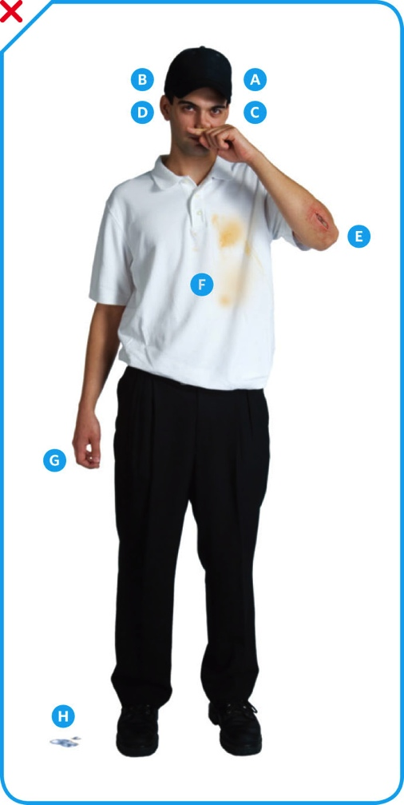
Personal Hygiene &
Work Habits (continued)
Actions that can lead to contaminated
food:
  Scratching the scalp
  Running fingers through hair
  Wiping or touching the nose
  Rubbing an ear
  Touching a pimple or infected wound
  Wearing a dirty uniform
  Coughing or sneezing into the hand
  Spitting in the operation
28
Notes:
Instructor Notes
People often do things that can spread pathogens without knowing it. To avoid causing a foodborne illness, food handlers must pay close attention to what they do with their hands and avoid the actions indicated in the slide.

Slide 29
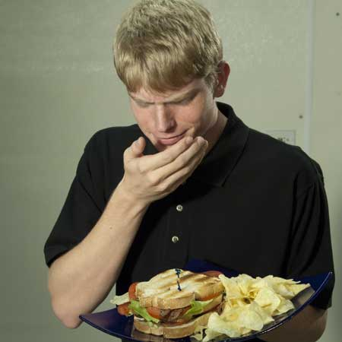
Personal Hygiene &
Work Habits (continued)
People can contaminate food when—
  They don’t wash their hands after using
  the restroom.
  They come to work when they are sick
  or have been in contact with a person
  who is sick.
  They sneeze onto food or food-contact surfaces.
  They touch dirty food-contact surfaces and equipment and then touch food.
Avoid personal behaviors that can contaminate food!
29
Notes:
Instructor Notes
Poor hygienic practices cause food employees to become the primary vehicle for transmitting harmful bacteria and viruses to food:
Improper handwashing;
Working when sick with an infectious disease that can be transmitted through food or being in contact with a person who has an infectious disease;
Sneezing onto food or food contact surfaces; or
Touching clean food contact surfaces after performing custodial duties or handling soiled surfaces and equipment.
Food employees must avoid personal behaviors that can contaminate food.

Slide 30
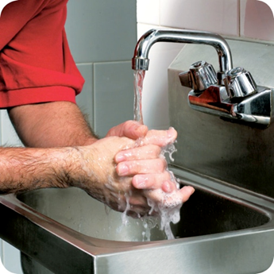
Personal Hygiene &
Work Habits (continued)
Hand-washing “...the single most important means of preventing the spread of infection.” –Centers for Disease Control and Prevention
Proper and frequent hand washing and proper use of disposable gloves can reduce the risk of transmission.
30

Slide 31
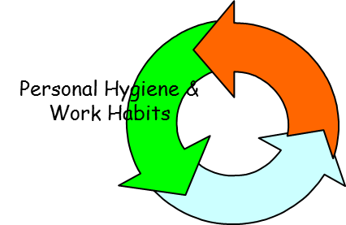
Handwashing Standards
Use only designated hand wash sinks.
Hand wash sinks must be supplied with the
following items at all times—
  Soap;
  Hand drying device (paper towels or approved air-knife system);
  Trash receptacle (for paper towels).
Food events with no access to hand washing sinks should have access to hand sanitizers and disposable gloves
31

Slide 32
Handwashing Standards
When to wash your hands
  Before you begin handling food
  After using the toilet
  Sneezing, coughing, or blowing your nose
  Before and after handling raw meat, fish, or poultry
  After handling garbage or dirt dishes
  After coming back from a break, eating, smoking, or touching hair
  Any breaks between food handling
  Putting on chapstick

Slide 33





Proper Handwashing Procedure
Handwashing is a 20-second process—
1. Wet hands with hot running water
2. Apply soap
3. Rub hands together for 20 seconds
**Clean under fingernails, between fingers, and the forearms
4. Rinse thoroughly under running water
5. Dry hands completely
33
Notes:
Instructor Notes
Because handwashing is the most important part of personal hygiene, it is important to ensure that it is being done correctly. You may be thinking that the procedures for properly washing your hands is pretty obvious, but believe it or not, many food handlers do not wash their hands the correct way or as often as they should.
Handwashing is a 20-second process.
Wet hands using running water that is as hot as you can comfortably stand. It should be at least 100°F (38°C).
Apply enough soap to build up a good lather.
Scrub your hands together for 15 to 20 seconds. Be sure to clean under fingernails and between the fingers, and include the forearms about 3 to 4 inches above the wrist.
Rinse thoroughly under running warm water.
Finally, completely dry the hands and forearm using a single-use paper towel or hand dryer.
Consider using the paper towel to turn off the faucet and to open the restroom door.
Some facilities may have employee hand wash sinks that are equipped with an air-knife system that delivers high-velocity, pressurized air at ambient temperature. If this type of device is used, employees must ensure hands are thoroughly dried before leaving the hand wash station. Wiping residual moisture onto your work clothes or apron is strictly prohibited.

Slide 34
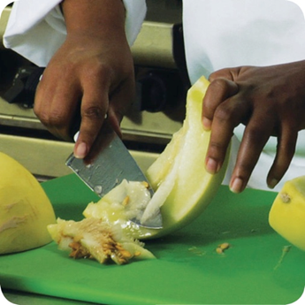
Single-Use Gloves
Disposable Glove Use Policy—
  Optional for use when preparing foods that require
  further cooking before being served to customers
  ONLY when a handwashing sink is available.
  NEVER used in place of handwashing.
  NEVER washed and reused.
Ready-to-Eat Foods
  Bare-hand contact with RTE foods is prohibited.
  Options include using—
    Disposable gloves;
    Utensil;
    Food-grade tissue paper.
34
Notes:
Instructor Notes
Food can become contaminated when it has been handled with bare hands. This is especially true when hands have not been washed correctly or have infected cuts or wounds.
TB MED 530 specifies that wearing disposable gloves is not required when handling ready-to-cook foods . A ready-to-cook food is a raw food that is being processed and will be cooked prior to being served to customers.
The TB MED does, however, prohibit bare-hand contact with ready-to-eat foods. Using disposable gloves when handling RTE foods is one of many options. If a utensil or food-grade tissue paper is suitable to prevent bare-hand contact with the food, then disposable gloves are not required.
When disposable gloves are being used, there are a few rules that must be followed:
Never use disposable gloves in place of proper handwashing;
Never wash and reuse disposable gloves – they are for single-use only.

Slide 35
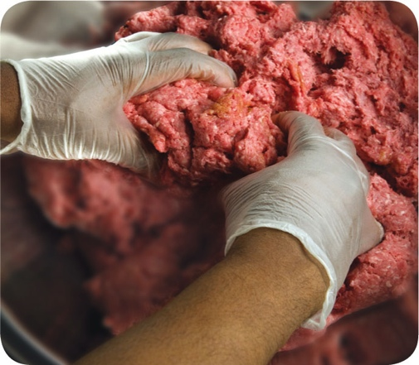
Single-Use Gloves (continued)
Wearing the gloves—
  Wash and dry hands before putting on gloves.
  Select the correct glove size to ensure proper fit.
  Hold gloves by the edge when putting them on.
    NEVER blow into gloves
    NEVER roll gloves to make them easier to put on
  Check for rips or tears.
When to change gloves—
  When soiled or torn.
  Before beginning a different task.
  After interruptions of the immediate task.
  After handling raw meat, seafood, or poultry and before handling ready-to-eat food.
35
Notes:
Instructor Notes
(Click the mouse to display the first discussion point)
When disposable gloves are used, care must be taken to avoid contaminating the gloves when putting them on.
Hands must be washed before putting on gloves and when changing to a new pair.
Gloves that are too big will not stay on. Those that are too small will tear or rip easily.
Some food handlers and customers may be sensitive to latex. Consider providing gloves made from other materials.
(Click the mouse to display the second discussion point)
Be sure to change your gloves—
When they become damaged or soiled by contact with something other than the food task at hand;
When changing tasks or there is an interruption in the task; and
When gloves were used to handle different raw protein foods and before handling foods that are in a ready-to-eat form.

Slide 36


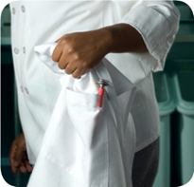
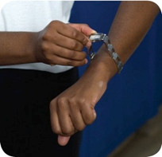
Uniform Standards
Clean Uniforms
  Wear clean uniform or clothing daily;
  Change outer clothing when it becomes
  heavily soiled with food debris during the
  course of the day.
  Remove aprons when leaving
  food-preparation areas.
Remove jewelry and watches from hands and arms when preparing, cooking, or serving food. Exceptions allow wearing:
  Single, plain/smooth ring/wedding band;
  Medical alert bracelet or necklace.
36
Notes:
Instructor Notes
All food employees must come to work with clean clothes every day.
Outer clothing for workers must be free of soil residues, pet hair, food residues, and chemical residues (such as gas or oil from your vehicle, or cleaning compounds).
If possible, food handlers should change into work clothes at work. Dirty clothing stored in the operation must be kept away from food, food prep areas, food storage areas, and clean equipment and utensil storage areas. Facilities generally have a designated break room or employee changing area. You can do this by placing them in nonabsorbent containers or washable laundry bags.
Food handlers may not wear jewelry on their hands or wrist when conducting any food handling task, such as food prep, cooking and serving. Watches, bracelets, and rings must be removed. The only acceptable jewelry that is exempt for this prohibition are--
A single, plain and smooth ring or wedding band. Any ring that contains engravings, decorative etching, or stones may not be worn.
A medical alert bracelet.
There is no prohibition within the Army’s food safety standard that prohibits wearing earrings, facial or other body piercings, and necklaces. A restriction, however, may be applied through a formal policy published by the installation medical authority if food safety hazards arise as a result of this type of jewelry. Additionally, the food establishment manager or the organization who is sponsoring the food establishment (such as AAFES, NEX, or MWR) may further impose a jewelry restriction. Employees should consult with their supervisor for disclosure of local uniform guidelines.

Slide 37

Uniform Standards (continued)
Adequate Hair Restraints
  Clean hat or hair net.
  Hairnets
  Beard-net (snood) and arm-net/sleeve must be worn if hair exceeds ¼-inch on face or arms.
Hats
  Paper/disposable hat disposed at end of shift/day.
  Long hair must remain pinned/tied and tucked under hat or contained by hairnet.
  All males must wear a hat even if head is clean shaven – hats prevent perspiration from dripping onto surfaces.
37
Notes:
Instructor Notes
All food employees are required to wear an effective hair restraint which may consist of a hair net or hat. Employees generally exempt from this requirement include—
Counter staff who only serve beverages and foods that are protected by a wrapper or other type of packaging.
Hostesses and wait staff may also be exempt if it is determined that they present a minimal risk of contaminating exposed food or clean food equipment and utensils. Typically, if these personnel have long hair and carry large trays of food or multiple plates of exposed food at one time, a hair restraint will be required.
Food handlers with facial hair longer than 1/4 –inch must wear a beard restraint.
Long-haired individuals must ensure they wear their hat or hairnet in a way that effectively prevents loose hair from falling into food or onto surfaces. For example, wearing a hat tilted back on the crown of the head will not effectively restrain your bangs. Additionally, wearing a visor-style hat is usually ineffective because individuals tend to let their bangs hang freely above the visor or the visor is canted back on the crown of the head, allowing the bangs to hang freely under the visor.
If wearing a hat alone proves ineffective for retraining hair, additional controls such as hair ties used in conjunction with the had must be considered. Employees are cautioned not to wear hair accessories, such as bobby pins and barrettes, that could become physical contaminants. Hair restraints should be limited to items that keep hands out of hair and hair out of food.
Food employees who have clean shaven heads or extremely short hair must also wear an effective head covering to prevent perspiration from dripping onto work surfaces or food. The lack of absorbent material such as hair will cause perspiration to accumulate and drip freely from the head. Wearing a cloth or paper head covering is required and must be changed each day or more frequently if necessary.
False eyelashes can also become physical contaminants if they accidentally fall off. Although there is not current regulatory restriction for wearing false eyelashes it is recommended that they not be worn.

Slide 38
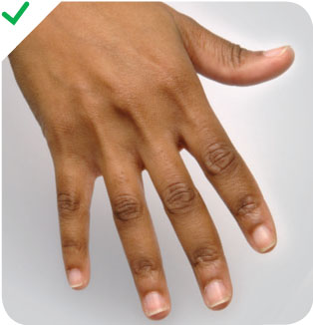
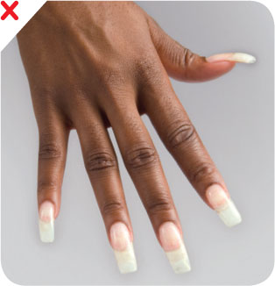
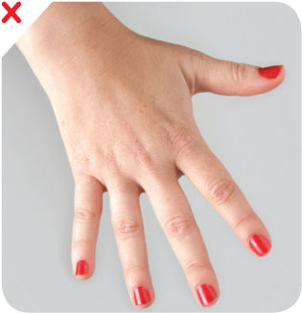
Hygiene Standards
Personal Hygiene & Work Habits
Fingernails
  Short (recommend no more than ¼ inch above the fingertip)
  Neatly trimmed & smooth
  No false nails, polish, or nail jewelry/ornaments
    Wearing disposable gloves does NOT dismiss this requirement.
38
Notes:
Instructor Notes
Long fingernails may be hard to keep clean and can rip gloves. Additionally, they can also chip or break off and become a physical contaminant to food.
Fingernails should be kept trimmed and filed. This will allow nails to be cleaned easily. Ragged nails can be hard to keep clean and the small crevices associated with ragged or torn nails may hold pathogens that are not easily removed during handwashing.
Do not wear false fingernails. They can be hard to keep clean and also present a physical food safety hazard if they break off.
Do not wear nail polish. It can disguise dirt under nails and may flake off into food.
All of these requirements are stated in the Tri-Service Food Code (TB MED 530) and apply to all food employees who perform food handling tasks. The requirements may not be waived by the food operation manager and wearing disposable gloves over long nails or polished fingers is not an acceptable practice.

Slide 39
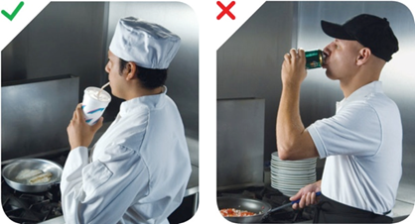
Hygiene Standards (continued)
No eating, chewing gum, drinking, or tobacco
use in kitchen (food prep) areas or serving lines.
  Use only designated break areas.
  Exception: Hydration beverage (e.g., water) in a closed container with straw.
Personal Hygiene & Work Habits
39
Notes:
Instructor Notes
Small droplets of saliva can contain thousands of pathogens. In the process of eating, drinking, smoking, or chewing gum or tobacco, saliva can be transferred to hands or directly to food being handled.
Food handlers must not eat, drink, smoke, or chew gum or tobacco when:
Preparing or serving food
Working in food prep areas
Working in areas used to clean utensils and equipment
Use a designated break area. Food storage areas are not appropriate for these activities.
The only exception to this policy is an employee may keep water in a closed container equipped with a straw in the immediate work area as long as it is not placed where accidental spillage onto food may occur.

Slide 40
Time & Temperature Controls
One of the critical factors in controlling bacteria
in food is controlling temperature.
Biological hazards already exist in/on food when it is purchased.
Bacteria will grow rapidly when food is held at unsafe temperatures for more than a few hours. For example—
  Ambient Temperatures:
    At 90ºF the number of bacteria on food will double every 30 minutes.
    Over 4 billion bacterial cells can result after just 4 hours at unsafe temperatures.
    Illness can occur after ingesting anywhere between a couple hundred to a couple thousand bacterial cells.
  Refrigeration Temperatures:
    At 26ºF the number of bacteria double every 60 hours.
40
Notes:
Instructor Notes
Time and temperature controls represent the second Layer of Protection.
Because harmful microorganisms cannot be seen by the naked eye and because we know foods can become contaminated during processing on the farm or at the manufacturing plant, we must assume that biological hazards are already present in the food when it arrives at your facility.
Even canned goods and dried grains and pasta may contain spores from harmful bacteria found in the soil. Remember, we said that dormant spores can “wake up” when environmental conditions are suitable to sustain bacterial growth. That means opened cans of vegetables and cooked rice and pasta are all capable of supporting bacterial growth.
When potentially hazardous foods are placed outside of safe temperature controls, pathogenic microbes will take a little bit of time to adjust to the new, more moderate environment and then will begin to grow rapidly, doubling in numbers every 15 to 20 minutes.
Although some microbes can grow under refrigeration temperatures, most pathogenic organisms grow best at temperatures that are greater than 41ºF and lower than 135ºF.
The growth rate of bacteria will increase significantly as temperatures begin to rise. In a few short hours, foods can become inundated with bacteria. For example,
At a temperature of 90ºF the number of bacteria on food will double every 30 minutes.
After only 4 hours the total number of bacteria can multiply to over 4 billion cells.
Illness can occur after ingesting anywhere between a couple hundred to a couple thousand bacterial cells.
If kept under refrigeration, the growth rate is much slower. At 26ºF it will take about 60 hours for bacteria to double just one time.

Slide 41
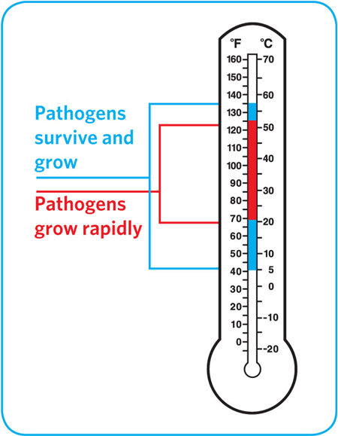
Time & Temperature Controls
Safe Temperatures—
Hot: 135ºF (57ºC) or above.
Cold: 41ºF (5ºC) or below
41
Notes:
Instructor Notes
Most foodborne illnesses happen because TCS food has been time-temperature abused. Remember: TCS food has been time-temperature abused any time it remains between 41ºF and 135ºF (5ºC and 57ºC). This is called the temperature danger zone because pathogens grow in this range. But most pathogens grow much faster between 70ºF and 125ºF (21ºC and 52ºC).
Food is being temperature abused whenever it is handled in the following ways: cooked to the wrong internal temperature, held at the wrong temperature, or cooled or reheated incorrectly.
The longer food stays in the temperature danger zone, the more time pathogens have to grow. To keep food safe, you must reduce the time it spends in this temperature range. If food is held in this range for four or more hours, you must throw it out.

Slide 42
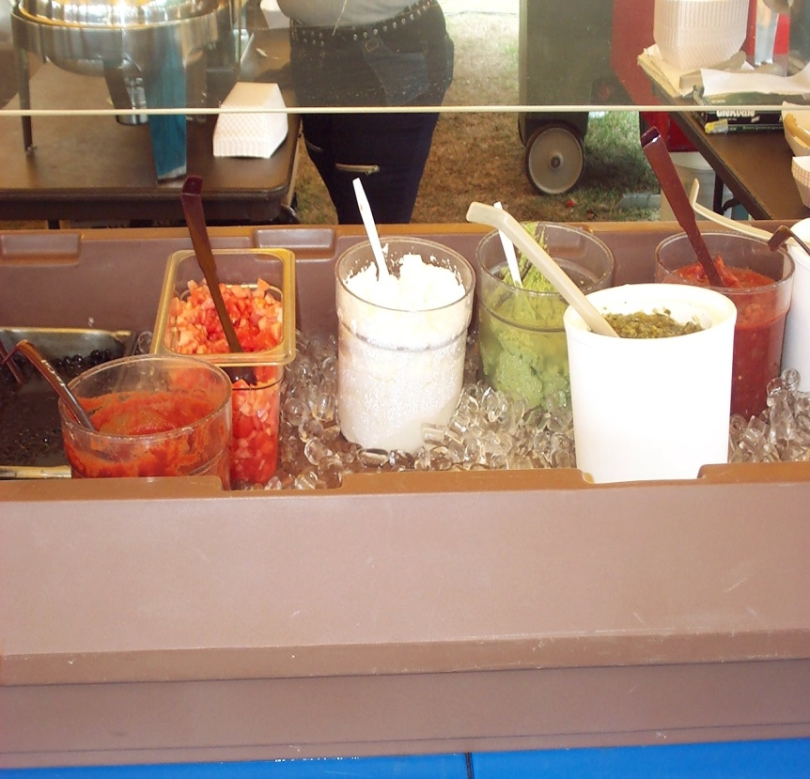
Temperature Controlled Processes
Time & Temperature Controls
Receiving—
  Timely transfer of foods to refrigerator or freezer when receiving deliveries.
Cold holding—
  During storage & service
  Check operating temperature of units
  Don’t over-pack units
Thawing—
  Do NOT thaw at room temperature!
  Thaw in a refrigerator that maintains foods cold at 41ºF or below; or
  Thaw as part of cooking process (frozen hamburgers on a grill).
  Thawing sealed & impermeable food packages under cold running water (<70ºF) is allowed, but least preferred.
    Max time = 4 hours from when the temperature of the thawed portion reaches 41ºF and includes time needed to prepare the food after thawing.
42
Notes:
Instructor Notes
In the next series of slides we are going to look at each of the temperature controlled processes that occur throughout a food operation. It is your responsibility as a food employee to ensure proper time and temperature controls are being achieved.
Time controls start when cold potentially hazardous foods are delivered to your facility. Transfer them to refrigerated or freezer storage as soon as possible.
Make sure the ambient temperature of cold storage units is operating at 41ºF or below. Do not over-pack cold storage units as this will reduce the circulation of cold air within the unit and may result in some products falling out of temperature compliance.
Never thaw frozen products at room temperature. Supervisors should plan ahead and allow sufficient time for thawing to occur under refrigeration. Other options for thawing include cooking foods from a frozen state, such as hamburgers. Thawing could be achieved under potable (drinking) running water as long as the product is sealed in an impermeable wrapper and the water temperature remains 70ºF or below. Also, if this method is used, you have a maximum of 4 hours to finish cooking or prepping the product. The 4-hour time period starts once any portion of the product reaches above 41ºF during the thawing process.

Slide 43
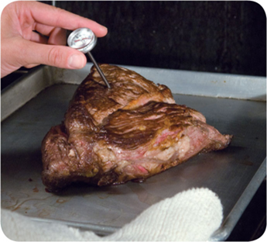
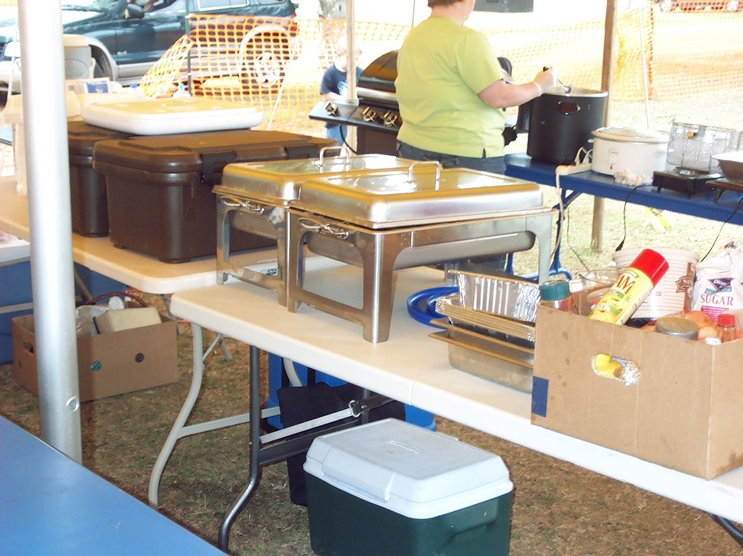
Temperature Controlled Processes (continued)
Food Preparation—
  Use small batch preparation to minimize the time food is held at unsafe temperatures during preparation.
Cooking—
  Check internal product temperature at the
  terminal stage of cooking.
  Spot check multiple pieces when individual
  portions are arranged on a baking sheet.
  Check thickest part of product.
Hot holding—
  Food must be 135ºF or above before
  being placed in hot holding.
Time & Temperature Controls
43
Notes:
Instructor Notes
Food employee can minimize the length of time food is exposed to dangerous temperatures during preparation by practicing small batch preparation. Only take out as much food as you can process in a short period of time. If it takes an hour or more to process what you’ve taken out of refrigeration, you are not adhering to the “small batch” principle.
Be sure to spot check the internal cooking temperature of foods at the terminal stage of cooking. For individual portion items cooked in the oven, spot check several pieced in the front and back of the oven. For uneven cuts of large meats or when roasting whole chickens or turkey, measure the thickest part of the product and stay off of the bone. Allow at least 15 seconds for the temperature reading to stabilize when spot checking food.
Hot holding units and chafing dishes are not designed to warm or heat food. They are meant to maintain food at its current temperature. Food must be cooked to the prescribed temperature and be placed into the hot holding unit while it is still hot (above 135ºF).
Keep foods covered when not being served.
Discard all food after 4 hours if temperature was not maintained.

Slide 44
Temperature Controlled Processes (continued)
Time & Temperature Controls
Cooling—
  Rapid cooling achieved by:
    Slicing bulk meats
    Transfer bulk products to multiple shallow pans
    Immersion in ice-bath and frequent stirring
    Loosely cover food containers before storing.
Cooling Criteria:
  Hot foods cooled to 70ºF or below within 2 hours, and then to 41ºF or below within 4 hours [6 hours for total process].
  TCS foods prepared from ambient ingredients—
    Cooled within 4 hours to 41ºF or below.
44

Slide 45
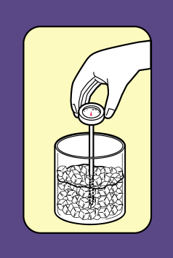
Thermometer Calibration
Time & Temperature Controls
Ice Point Calibration Method
Fill cup with ice;
Add cold water to cover ice;
Immerse thermometer probe;
Wait 5 minutes to allow temperature to stabilize;
Thermometer should indicate 32ºF—
  Follow manufacturer’s instruction to adjust calibration.
  For bi-metallic stem-type, adjust by turning the nut located under the dial.
  Calibration is achieved when scale indicates temperature within + 2ºF (+ 1ºC) of desired measurement.
Boiling Point Method
  Thermometers used for hot holding or cooking.
Ice Point Method
  Thermometers used for cold holding.
Calibrating at cold temperature may not result in calibration at the hot end of the thermometer scale.
45
Notes:
Instructor Notes
There are two simple methods used to calibrate food thermometers:
Boiling point method
Ice point method
Ideally, you should use a separate thermometer for monitoring hot and cold processes. A thermometer that is calibrated at the lower end of the temperature scale may not be calibrated at the higher end of the scale.
Look at the manufacturer’s specifications and instructions provided with your thermometer to identify the best method and recommended frequency for calibration.
(Click the mouse to reveal procedures for the Ice Point Method)
The ice point method of calibration takes less than 10 minutes to complete. Start by filling a cup to maximum capacity with ice. Add enough cold water to the cup to cover the ice. Immerse the thermometer to a depth that completely covers the sensing area of the probe and wait 5 minutes for the temperature to stabilize. The thermometer scale should indicate 32ºF. Keep the thermometer submerged in the ice while making any adjustments. Calibration is achieved when the temperature scale indicates the measurement is within plus or minus 2ºF.
Some digital display stem thermometers may not be designed to allow calibration by the user. If you are unable to make adjustments and the temperature reading is more than 2 degrees out of calibration, you must remove the thermometer from use. Remember, calibration that is off by 3 or 4 degrees on the cold end of the scale may be off by 10 or more degrees at the hot end of the scale. Some thermometers will require you to send the device back to the manufacturer for calibration. Consult with the manufacturer’s instruction for details.
When calibrating using the boiling point method, you must bring the water to a rolling boil and keep it boiling during the calibration process. Water boils at 212ºF; therefore, the thermometer should read between 210 and 214ºF. Care must be taken not to touch the bottom or the sides of the pot with the sensing part of the thermometer during calibration as this will result in a much higher reading.

Slide 46
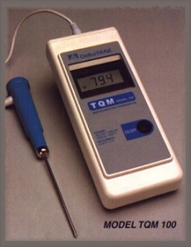
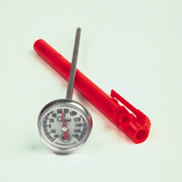
Thermometer Requirements
Time & Temperature Controls
Thermometers must be readily available for spot checking internal food temperatures.
  Verify food in hot & cold holding.
  Verify terminal cooking temperature was achieved.
  Calibrate daily to ensure accuracy.
  Sanitize between foods & prior to each use.
46
Notes:
Instructor Notes
Monitoring the ambient temperature of refrigerators, ovens, and hot holding units does not assure that proper food internal temperatures are being achieved.
Food employees should probe foods to verify internal product temperatures are maintained during hot and cold holding and to ensure minimum prescribed internal cooking temperatures are achieved to destroy harmful microorganisms.
Thermometers can lose their accuracy when they are bumped, dropped, or go through severe temperature changes. When this happens, the thermometer must be calibrated, or adjusted, to give a correct reading.
It is also important to wash, rinse, and sanitize thermometers before and after each use to prevent cross-contamination. Be sure the sanitizing solution you use is for food-contact surfaces.

Slide 47
Temperature Control
Food Type (Refer to TB MED 530 for complete listing) | Temp
Poultry & poultry products Stuffed meats & vegetables containing meat Leftovers & dishes containing leftover ingredients Microwaved foods | 165ºF
Sausage Ground meats Fish Cured, injected, or mechanically tenderized meats Bulk-prepared scrambled eggs | 155ºF
Whole muscle meats (lamb, beef, veal, pork) Made-to-order eggs | 145ºF
Cooked plant food that do not contain meat, poultry, fish, or eggs | 135ºF
Time & Temperature Controls
47
Notes:
Instructor Notes
This table identifies the minimum required internal cooking temperatures for different types of foods. We will look at examples for each on the next series of slides, but you should always refer to TB MED 530 for a complete listing and description of each product.
Cooking standards are based on targeted bacteria commonly found on specific foods. The standard is designed to destroy the most heat-resistant pathogen likely to be present. For example, although Campylobacter bacteria is more prevalent than Salmonella on chicken, poultry is cooked to 165 degrees to ensure any existing Salmonella is destroyed. The Campylobacter bacteria is destroyed at a much lower temperature.
When determining doneness of the food, probe the thermometer in the middle or thickest portion of the food. The food must be held at the minimum prescribed temperature for at least 15 seconds before it can be removed from the cooking device. To spot check individual portions of a product, such as chicken breasts laid out on a baking sheet, you must probe several pieces to verify doneness. Pieces located towards the front of the oven may not have reached the proper temperature, where as pieces towards the middle or rear of the oven may have already exceeded the required temperature.
Let’s take a closer look at the different products for each cooking requirement:

Slide 48
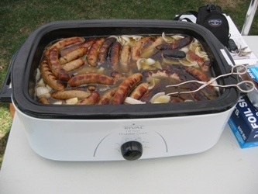
Temperature Control
HOT HOLDING
Maintain food
at 135 °F or above
  Food must be reheated prior to placing in hot holding
  take internal product temperature

Slide 49
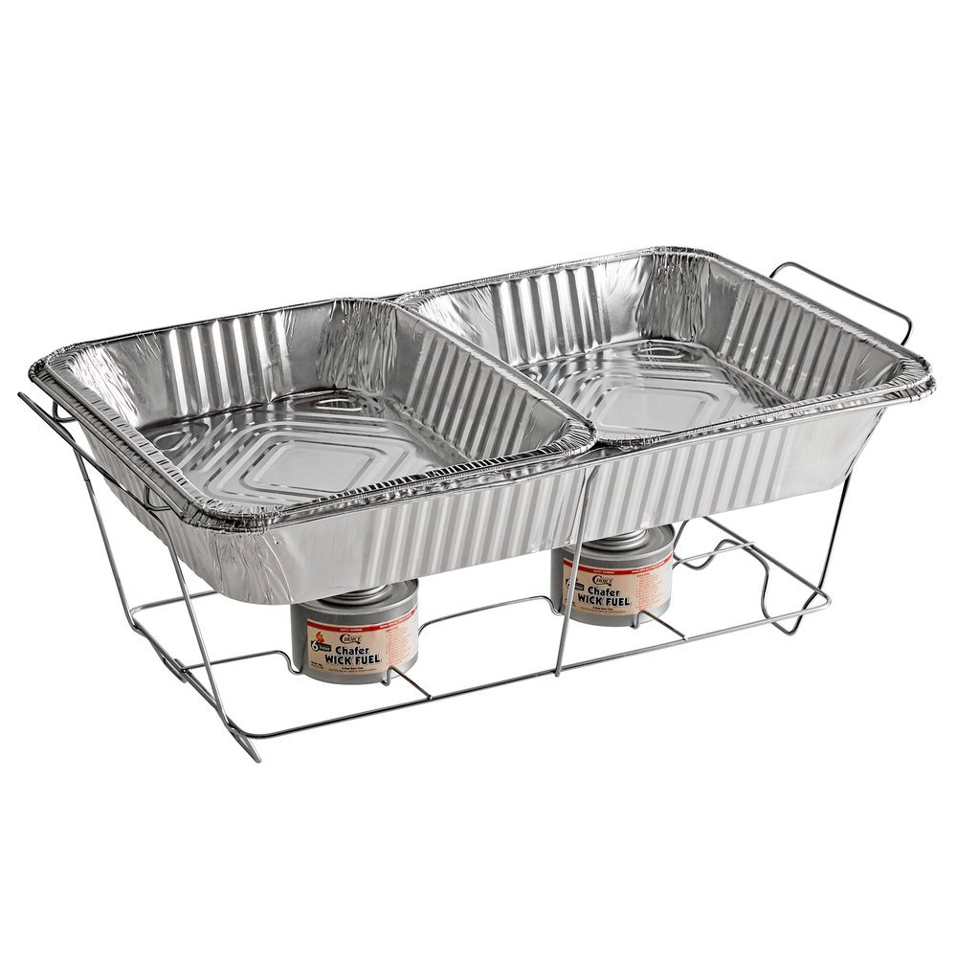
Temperature Control
HOT HOLDING
  Disposable chafing dishes
    (Used when electricity is not available)
    Place water in pan prior to adding food pans
    Allow time to warm up prior to placing food

Slide 50
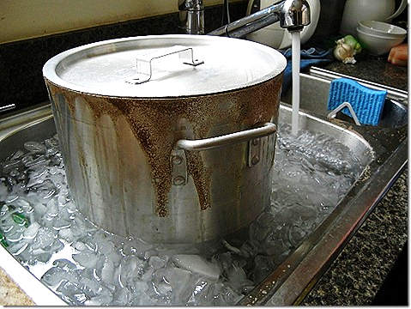
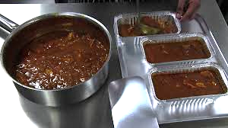
Temperature Control
COOLING
  Ice Bath (Food should have no contact with ice)
  Reducing Quantity (Smaller Batches)
Notes:
Cooked TCS FOOD shall be cooled within a total of 6 hours from 135°F (57°C) to 41°F (5°C) or less,
IAW the following criteria:
(1) Within 2 hours from 135°F (57°C) to 70°F (21°C); and
(2) Within 4 hours from 70°F (21°C) to 41°F (5°C).

Slide 51
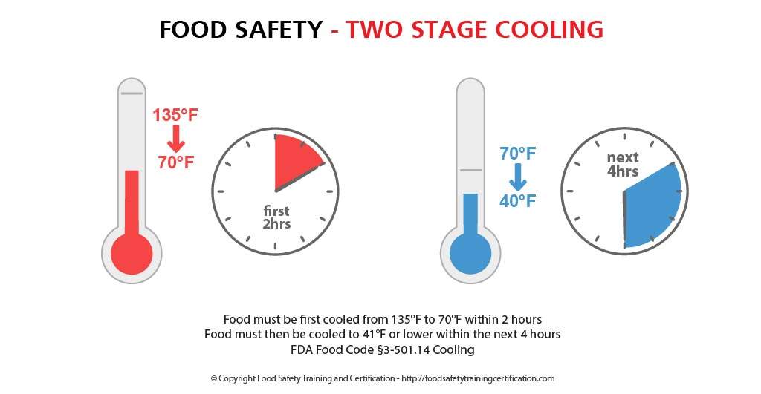
Temperature Control
COOLING
  Cooked TCS food must be cooled within a total of 6 HOURS
    Within 2 HOURS from 135°F to 70°F AND
    Within 4 HOURS from 70°F to 41°F

Slide 52
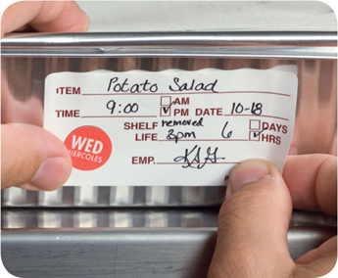
Time Without Temperature Control (continued)
4-hour rule: Hot & cold foods –
  Food held at 41ºF (5ºC) or less, or at 135ºF (57ºC) or higher before removing from temperature control.
  Label indicates date & time removed from temperature control.
  Label indicates the time that is 4 hour past the point when removed from temperature control. Food must be sold/consumed or discarded by this time.
6-hour rule: Cold foods only—
  Food starting temp is 41ºF (5ºC) or less before initiating Time control process.
  Food temperature does not exceed 70ºF (21ºC)
  at any time.
  Labeling requirements same as 4-hour rule.
  Sell, consume, or discard when food temp
  reaches 70ºF or 6-hour point, whichever comes
  first.
52
Notes:
Instructor Notes
Here are some basic rules to remember if Time as a Public Health Control has been approved for your operation.
The 4-hour rule may be applied to hot and cold TCS foods.
These foods must have a starting internal temperature that is either cold at or below 41ºF, or hot at or above 135ºF.
The food must be labeled to indicate the time that it was removed from temperature control, and
The label must further identify the point in time that is 4 hours from when the product was removed from temperature control.
Foods that reach the 4-hour retention point must be sold, consumed, or discarded at that time.
Foods remaining after the serving period may NOT be retained as a leftover, even if the total time the item was left outside of temperature control was less than 4 hours. For example, if a new pan of chopped eggs was place on the salad bar (without temperature control) 30 minutes prior to the end of the meal period, the eggs must be discarded at the conclusion of the meal period. If the salad bar is open to patrons following the regular meal period, the items may be kept on the salad bar outside of temperature control up to the time the 4-hour retention period expires.
The 6-hour rule may only be applied to cold foods.
The food must have been held under temperature control, 41ºF (5ºC) or lower, prior to being placed in a Time-controlled status.
At no time during the six hours may the food temperature exceed 70ºF (21ºC). Because of this restriction, food employees must monitor the food periodically to ensure the internal temperature does not exceed 70ºF. If it does, the product must be discarded immediately.

Slide 53
Cleaning & Sanitizing
Proper cleaning and sanitizing is the third layer of protection to ensure food safety.
Task: Cleaning and sanitizing food contact surfaces—
  Manual and mechanical pot/pan, equipment, & utensil washing
  Clean-in-place food equipment & food prep tables
  Dining room tables & condiment containers
  Beverage dispensers & serving lines
Proper Cleaning & Sanitizing
  Unsanitized food utensils in DFAC resulted in 169 service members getting sick; 75 hospitalized
53
Notes:
Instructor Notes
So far we’ve talked about two of the three layers of protection that address the five major food safety risk factors. The last layer of protection is Proper Cleaning and Sanitizing.
The foodborne illness outbreak depicted on this slide occurred in a deployment setting in a contracted dining facility operating at a large forward operating base. The outbreak investigation found that the facility did not have adequate hot water to sanitize food equipment during manual washing and, although chlorine bleach was available in the facility, only a trace amount was found in the sanitizing rinse compartment during manual pot and pan cleaning and there was no residual in the spray bottles used to sanitize food contact surfaces. Further review of the inspection history indicated that chlorine sanitizing solutions were often found at zero or very low concentrations.
Proper execution of equipment and facility sanitation tasks is essential for protecting food from cross contamination. Specific areas of concern include:
Managing manual and mechanical dish washing activities;
Large food equipment that require cleaning-in-place and tables used to prepare foods;
Maintaining the dinging room and serving lines, to include food and beverage dispensers and condiment containers.

Slide 54
Methods for Sanitizing
Chemical Sanitizers: chlorine (bleach), quaternary ammonia, or iodine—
  Food prep tables, dining room tables, food/beverage dispensers, & condiment containers
  Used when hot water sanitizing cannot be achieved during mechanical or manual warewashing.
  Requires longer time for treated surfaces to air dry.
Proper Cleaning & Sanitizing
Chemical Sanitizing
Sanitizer Concentration | Chlorine |  | Quats | Iodine
 | 100 mg/L | 50 mg/L | varies* (< 200 ppm) | 12.5 – 25* mg/L
Contact Time | 15 sec | 7 sec | 30 sec | 30 sec
Water Temp | 55ºF (13ºC) | pH <10, 100ºF (38ºC), or pH <8, 75ºF (24ºC) | 75ºF (24ºC) | 68ºF (20ºC)
Water pH | 8 or 10 |  | n/a | < 5.0*
* Solution concentration prepared per manufacturers’ instruction; pH for iodine must not exceed manufacturer’s specification.
54
Notes:
Instructor Notes
When hot water sanitizing cannot be achieved, an EPA-approved chemical sanitizer must be used. These include a bleach solution, quaternary ammonia (commonly referred to as “quats”) or iodine.
Typically, chemical sanitizers are used on food preparation tables, food and beverage dispensers, and dining room tables.
When chemical sanitizers are used for manual warewashing, more time will be needed to allow sanitized utensil and dishware to dry because the reduced temperature of the rinse water will not promote rapid evaporation during drying. As a result, additional drainboards may be needed to allow items to air dry.
The table on this slide identifies the required chemical concentration for each sanitizing agent. Each of these concentrations prescribes a minimum contact time with the equipment surface to ensure adequate reduction in the number of microorganisms present. Contact times are dependent on the temperature and the pH of the water. For example,
A 15-second contact time is required when the chlorine concentration is 100 milligrams per Liter (or 100 parts per million) and the water temperature is cool or lukewarm at about 55ºF. Note: if the water temperature is less than 75ºF, the 15-second contact time must be applied.
If the water temperature is raised to 100ºF, a reduced chlorine residual of 50 mg/L and a reduced contact time of 7 seconds is adequate.

Slide 55
When Chemical Sanitizers are Used…
Proper Cleaning & Sanitizing
Prepare fresh solution daily and as often as necessary to maintain proper concentration.
  Concentration will dissipate over time, by heat (hot water), contamination (food debris), & soapy water.
Prepare according to manufacturer’s instruction.
Do NOT mix different chemical agents in the same solution.
55

Slide 56
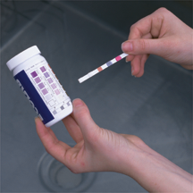
Chemical Sanitizers (continued)
Use chemical test kit or test paper to verify concentration of the prepared solution—
  Conducted each time a solution is prepared!
  Minimum required concentration achieved.
  Maximum concentration NOT exceeded.
  Spot check throughout the day or period of use.
Second clear water rinse required when
sanitizer concentrations are exceeded—
  Chlorine > 200 mg/L
  Quats > 200 mg/L
  Iodine > 25 mg/L
Proper Cleaning & Sanitizing
56
Notes:
Instructor Notes
A second clear water rinse is required any time a the chemical sanitizer concentration meets or exceeds the values presented on the slide.

Slide 57
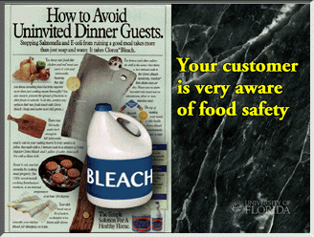
Preparing Bleach Solutions
Use only plain, liquid-type, household bleach.
  Scented & gel products prohibited!
  Industrial-strength products prohibited!
  Check product’s base concentration (5.25 - 6% or
  8.25% strength) to ensure proper mixing formula is used.
Preparation Type | Chlorine Product Base Strength
 | 5.25% to 6% | 8.25%
Bulk (sink) | 2 Tablespoons (30 ml) per 4 gallons (15.2 L) water | 4 teaspoons (20 ml) per 4 gallons (15.2 L) water
Spray Bottle | ½ Tablespoon (7 ml) per 1 gallon (3.8 L) water | 1 teaspoon (5 ml) per 1 gallon (3.8 L) water
57
Notes:
Instructor Notes
Only chlorine products that are EPA-approved for food service may be used for sanitizing food contact surfaces and equipment.
Previously, household-type bleach manufactured in the United States had a base strength between 5.25 percent and 6 percent. US products are now formulated with a 8.25 percent base strength.
Many foreign brands are manufactured with a much lower concentration, usually around 3.25 percent.
Always look on the label to determine the actual base concentration of the product you are using.

Slide 58
Preventing Contamination
Protect cleaned & sanitized items from contamination between uses—
  Store away from chemicals, soiled linens, & soiled dinnerware or equipment.
  Keep storage & drying racks/shelves clean.
  Store plates, cups, & bowls inverted or covered.
  Store silverware with handles facing up.
Proper Cleaning & Sanitizing
Hygienic Practices:
Wash hands before handling clean/sanitized items.
Handle cups, glasses, bowls, plates, silverware, & utensils without touching inside surfaces or surfaces that contact food or the user’s mouth.
58
Notes:
Instructor Notes
Protect all cleaned and sanitized surfaces from contamination by—
Storing them away from chemicals and soiled items.
Keeping storage racks and shelves free of food residues, dust, and debris.
Storing plates and cups inverted or covered.
Storing bulk silverware with the handles facing up. Silverware wrapped in linen or paper napkins must also be stored in a protected area.
Always wash your hands before handling cleaned items.
Take care not to touch the surface of plates, glasses, and silverware that come into contact with food or the patron’s mouth.

Slide 59


